Slide 1
INTERACTIVE NOTBOOK topic: STATISTICS class: teacher: Semester 2, Term 3

Slide 2
Contents
Glossary or Formula Page
Page
Date
Description
Word
Description
2
3

Slide 3
Tasks
24
7
30
Topic
Essential Question
Questions
Notes
Summary
8
9

Slide 4
24
7
30
Back to back Stem and leaf plots
Date
EQ – How do we create a back to back stem and leaf plot?

Slide 5
From previous Lessons
During the summer, Maddie plays a softball league. Her teams scores are
19, 15, 22
10, 37, 26
37, 12, 5
37, 19, 10
39, 16, 8
CREATE a stem and leaf plot
Mean? Median? Range?
0 | 5 8
1 | 0 0 2 5 6 9 9
2 | 2 6
3 | 7 7 7 9
20.8 19 34

Slide 6
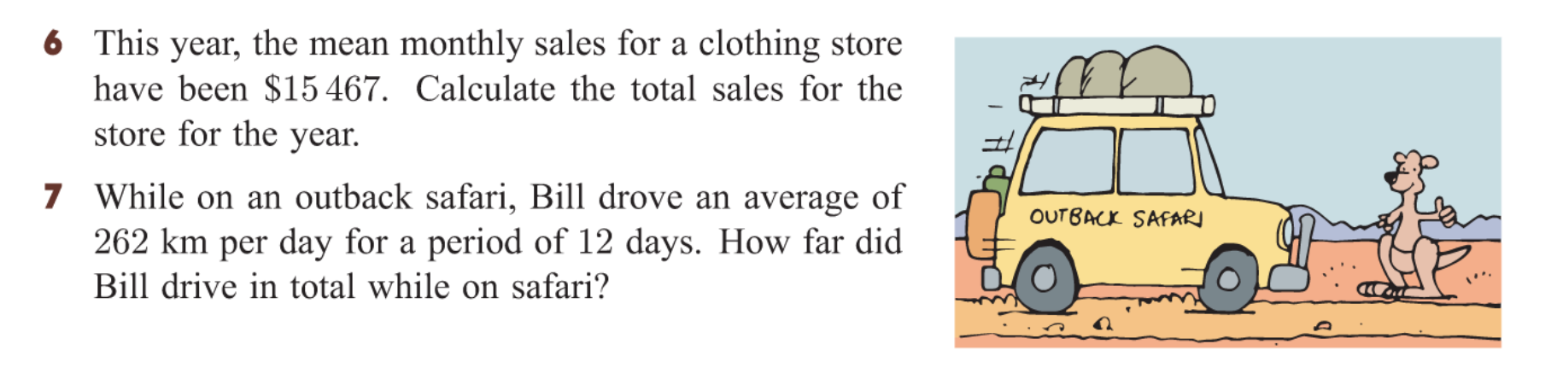


Slide 7
24
7
30
Back to back Stem and leaf plots
Date
EQ – How do we create a back to back stem and leaf plot?
Why do we use it?
To display two related data sets.
Example:
Mr Ships an Mr Chops class sat an exam (copy into books)
Mr Ship’s class |  | Mr Chop’s class
3 1 | 5 | 0 1 1 3 5 7
8 8 7 5 | 6 | 2 3 5 5 7 9 9
6 4 4 2 1 | 7 | 8 9 9
7 4 3 | 8 | 0 3
6 | 9 | 1

Slide 8
Hands up – stand up – pair up
In your teams of two can you WRITE THE QUESTION and answer them together.
5 questions altogether
10 minutes timer
Be prepared to share at the end!!

Slide 9
24
7
30
Back to back Stem and leaf plots
Date
EQ – How do we create a back to back stem and leaf plot?
Which class had the most students?
What were the lowest & highest scores from each class?
What were the median scores from each class?
Which class could be described as symmetrical and which is skewed?
Which class has the better results
Mr Ship’s class |  | Mr Chop’s class
3 1 | 5 | 0 1 1 3 5 7
8 8 7 5 | 6 | 2 3 5 5 7 9 9
6 4 4 2 1 | 7 | 8 9 9
7 4 3 | 8 | 0 3
6 | 9 | 1

Slide 10
Kahoot ☺
https://play.kahoot.it/#/k/99182d84-9b43-43fb-a1c9-15598f26f28e
No phone?
No worries…
Write the answers in your book

Slide 11
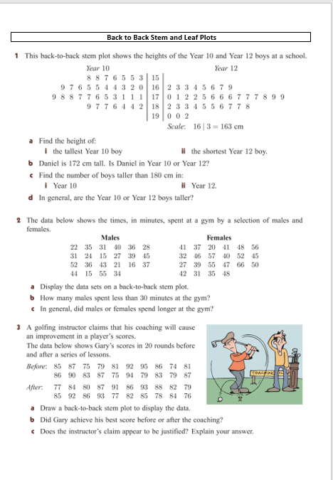
Task
Worksheet
(back to back) STEM AND LEAF PLOTS

